Slide 1
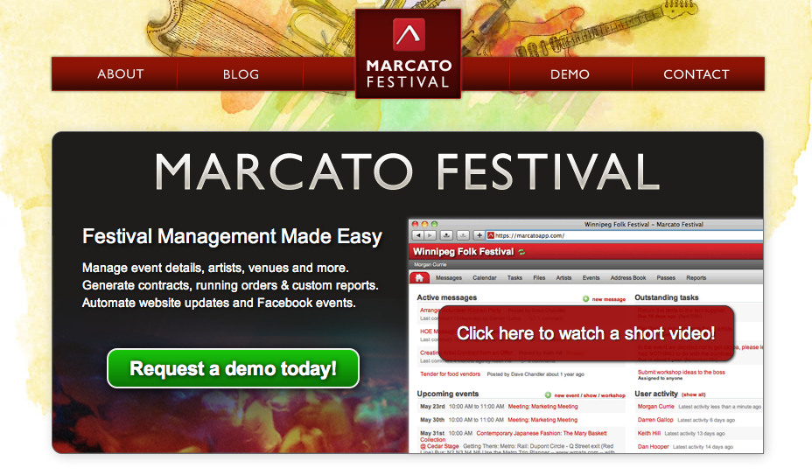
Notes:
Introduction of me
Introduction of Marcato. When founded, our current clients
Celtic Colours, Canada Games, Luminato, The Stan Rogers Folk Festival, Winnipeg Folk Festivals, Halifax Pop Explosion, Peats Ridge and Sydney Blues Festival in Australia

Slide 2
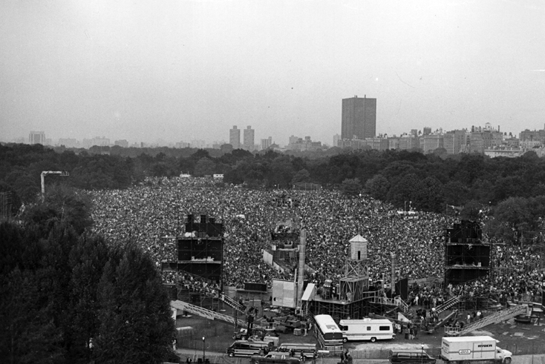
Festivals Built On Passion
Notes:
Festivals are built on Passion
Passion for music, passion for the community,
The problem is the volume of logistics can get in the way. Spend more time growing your festival, working with artists and your community and less time copy and pasting and entering data

Slide 3
YOU’RE ONLY USING 10% OF MY BRAIN!!
Notes:
Then computers came, they were supposed to help

Slide 4
The Solution Option 1
Build your own solution
Product planning and scope document
Initial development costs
Alpha, beta process
Tweaks
Hosting, support
Training
TOTAL = x times 3 then more money each time the space and your needs changes….

Slide 5
The Solution Option 2

Slide 6
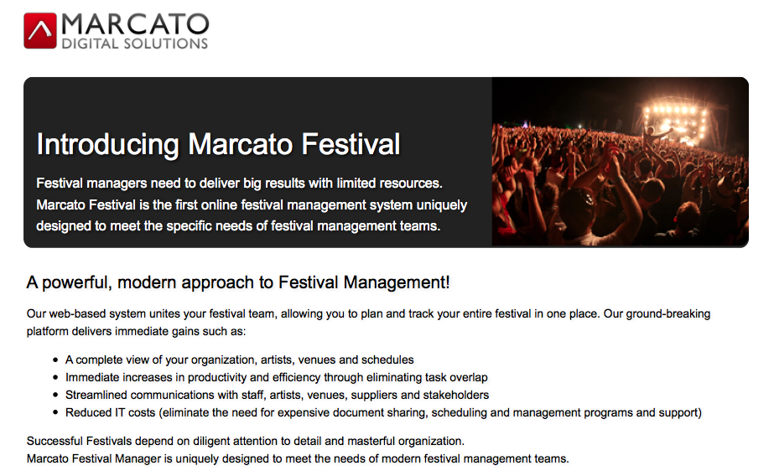
Notes:
The idea here is to produce big results with limited resources
All of your festival data in one place
- Working more efficiently
- Streamlined communication with your staff, team, volunteers and artists
- Reduced IT costs. It does not make sense for everyone to build custom systems from scratch

Slide 7
Get More info
marcatofestival.com/eurosonic
darren@marcatodigital.com
twitter.com/darrengallop
I AM HERE UNTIL SUNDAY MORNING IF YOU WANT TO CHAT!

